Slide 1
DRIVER – A World Bank Tool for crash data collection WORKSHOP TOWARDS THE ESTABLISHMENT OF A ROAD SAFETY OBSERVATORY IN AFRICA Dakar, February, 2018
Dr Soames Job
Global Lead Road Safety
Head of the Global Road Safety Facility,
World Bank

Slide 2
Overview of talk
The Road Safety Challenge
DRIVER Program
What is it
Advantages
Advantages for an African Road Safety Observatory
What is required to use it
Example uses What it can do

Slide 3
Deaths per 100,000 people
For the 9 countries here,
the average is 27.5

Slide 4
Pedestrians and Motorcycle deaths
are more likely to be under-estimated

Slide 5
Priority: Road safety is a crisis - and urgently needs more funding and a real plan
We will not meet the Decade and SDG targets
In four years, annual deaths must drop by more than 600,000 from the 1.25 million baseline and injuries must drop by 25 million. But, deaths are increasing.
We need to push harder now, and we need to change to game.
Some brutal predictions (part of a position paper we are preparing):
2013 = 1.24 million deaths
2016 = 1.34 million deaths …. 2.7% increase per year
Simple extrapolation:

Slide 6
Prediction, with business-as-usual
Extrapolating the current increase:
For 2018 to 2030, inclusive =
21.7 million deaths
875.7 million injuries
from road crashes globally

Slide 7
The DRIVER Platform: What is it
DRIVER = Data for Road Incident Visualization, Evaluation, and Reporting
A crash data storage, mapping and analysis system
Uses google street maps
The DRIVER platform developed and pilot tested by the World Bank in the Philippines (with thanks to Holly Krambeck and team)
Can be adapted to many countries
Has proven itself to be an effective viable road safety support solution

Slide 8
DRIVER: Advantages
Available for free on the World Bank GitHub open source code repository:
Customizable data entry fields
Easy to deploy at limited cost due to its Open Source platform
Adaptable to almost all countries, states, and cities, through its use of Open Street Map as the mapping platform
Provides key tools for recording and managing road safety data, including analytical tools for blackspot prediction, estimating the economic costs of crashes for a selected area, and tracking efficacy of road safety interventions
A public-facing website and tools for downloading anonymized data for third-party analysis
The platform is likely to become more widespread as the World Bank and GRSF support its promotion into countries and cities.

Slide 9
DRIVER: Advantages for an African Observatory
Uniform data processes, even if not identical data fields
Cross country help with expertise and usage
Can share the public-facing website of selected downloaded anonymized data
Everyone has existing data systems of various levels of function, but this sets an equally shared process

Slide 10
DRIVER: What is required to use it
Note the Flexibility =
Customized data entry fields for each country (low cost work) [or an agreed dataset]
Data entry (by existing or improved processes) into the system
Opportunity to enter earlier data (with correction for omissions) or not.

Slide 11
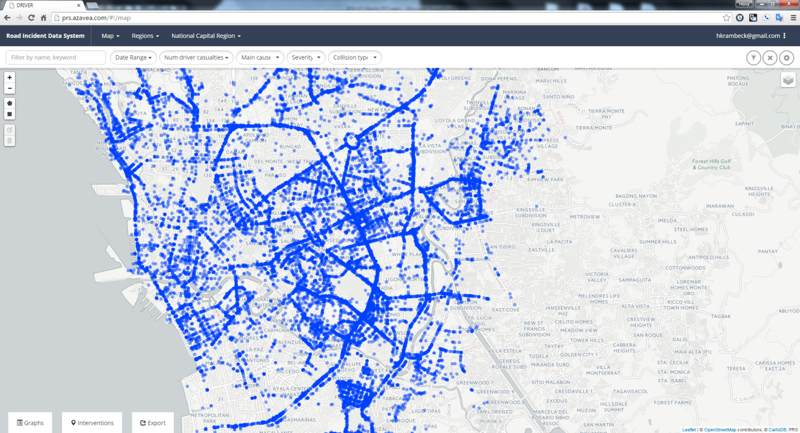
DRIVER: What can it do

Slide 12
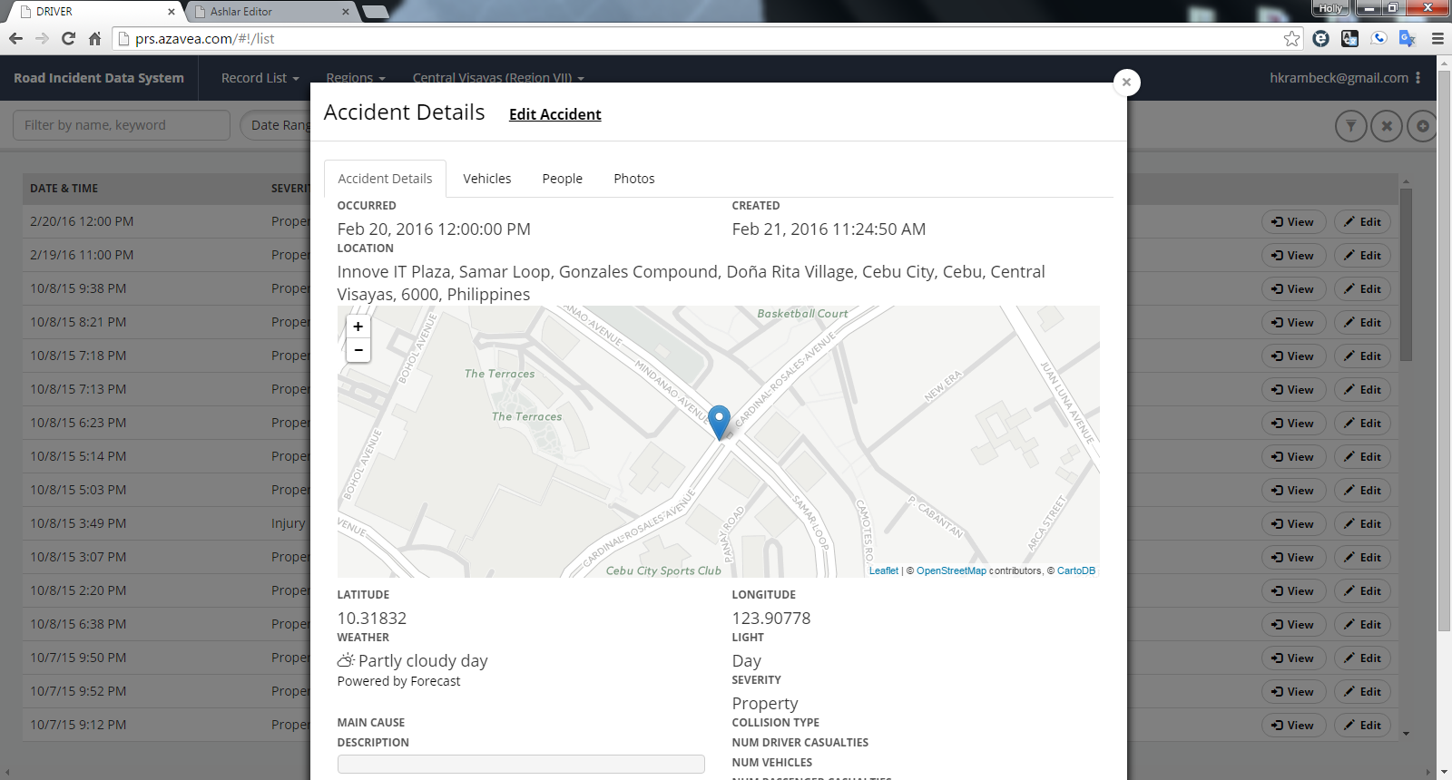
DRIVER: What can it do

Slide 13
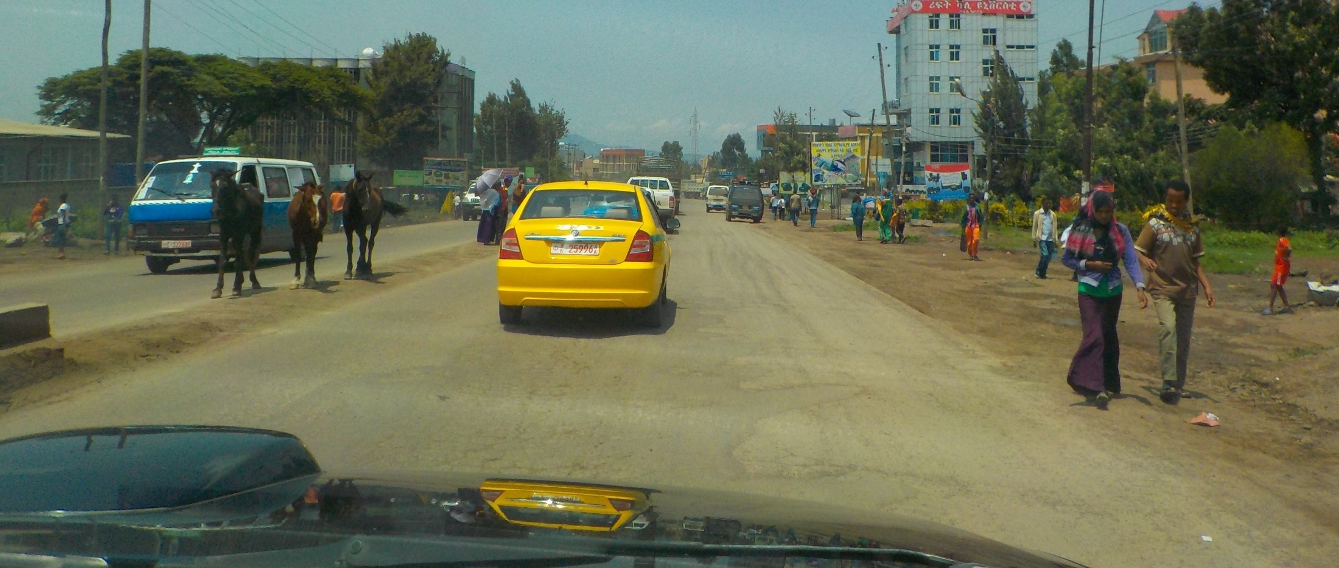
Thank you for your attention Discussion and Questions

