Slide 1
Integrated Road Traffic Information
Kevin Kara-Vala
Divisional Head: Road Traffic Information Systems
Road Traffic Management Corporation

Slide 2
Challenges Faced by RTMC
Lack of Credibility
Dispersed Local Crash Information Systems
Credible Crash Investigation Information
Report on ±1,83% of all crashes
Information gaps
Notes:
Report on less than 1,83% of all crashes (Cost of Crashes published Seprember 2017

Slide 3
Partner with Reputable Organisations
Partnered with CSIR on Cost of Crashes (2016) & Distracted Driving (2015)
Partnering with SAMRC-UNISA VIPRU with research on effects of Alcohol on road crashes (2018)
Notes:
with SAMRC-UNISA VIPRU = South African Medical Research Council – University of South Africa - Violence, Injury and Peace Research Unit (VIPRU)

Slide 4
National Crash Data Management System
Cost saving
Effective Analysis as integrated with MV and Driver Register
Improved Reporting with system controls for contributing factors
Collection of data remains a challenge

Slide 5
Limited Crash Investigation Capacity
Investigate wrong problem e.g. tyre burst due to subjective reporting
Develop resources from Traffic Fraternity
Share information from Private Sector e.g. Insurance sector
2013-2016 fatal crash data shows that Drivers & Passenger fatalities are declining – Pedestrians increasing

Slide 6
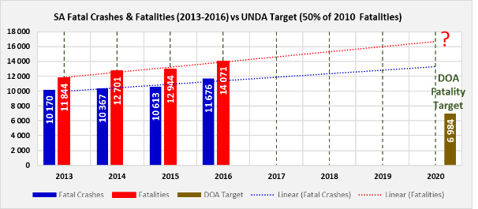
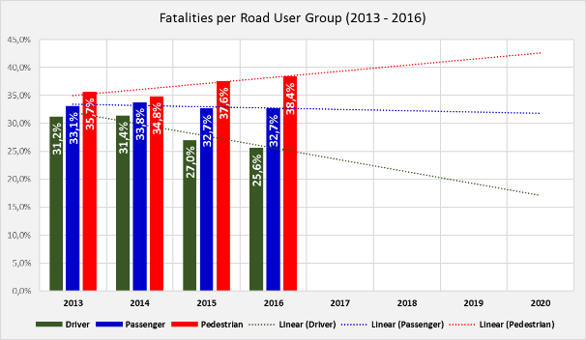
2013 – 2016 Fatal crash data Analysis

Slide 7
Reporting on Fatalities
Cost of Crashes highlighted that only ±1,83 % of crashes are fatal
Difference between injury and fatality is only luck – Human body frail
Need to capture all crashes to accurately identify the trends and predict the future

Slide 8
Information Gaps
Modify the ideal reporting to cater for information gaps that exist; e.g. Lack of Geolocations led to Interim HazLocs using Police Station reported data
Similarly use fuel sales as ratio instead of million kilometres travelled

Slide 9
Cooperation with Other African Countries
1
No Formal Cooperation
2
NCDMS developed on National Traffic Information System (NaTIS) and is also used by Lesotho and Namibia thereby facilitating sharing

Slide 10
Expectations
Improving Data Collection – Active Citizenry
Validation of current Data Indicators
Examples to enrich current information set
Integrated platform to share data
Possible PPPs / Collaborative road safety research

